Slide 1

Smart Healthcare Sytem

Slide 2
PROJECT MEMBERS
IQRA MUZAFFAR
HOORIA AZEEM
2020-CE-45
2020-CE-46
PALWASHA ZULFIQAR
2020-CE-48

Slide 3
CONTENTS
TASKS
5
7
REQUIREMENTS
TOOLS
8
9
FEASIBILITY
USE CASE DIA
DFDs
UI DESIGN
DATABASE DIA

Slide 4
Problem Statement
Automate a Hospital System
Appointment Management
Record Maintenance
Avoid unnecessary waiting

Slide 5
MAJOR FUNCTIONALITIES
EMR
OCR
ELECTRONIC MEDICAL RECORD
Optical Character Recognition
Contains the medical and treatment history of the patients
Quickly scan, store, and search for a patient's medical history.

Slide 6
EMR-TASKS
DESIGN
CREATING PANELS
Manage all the areas of a hospital
Admin, Patients, and Doctors
TASKS
ONLINE APPOINTMENTS
TREATMENT,BILLING AREAS
Treatment, prescription and billing areas are made efficient.
Patients can make appointments online

Slide 7
Preliminary Requirement Analysis
ADMIN PANEL
DOCTOR’S PANEL
PATIENT’S PANEL
DATABASE
Login
Doctors Data
Patients Data
Pending Appointments
Departments
Treatment kinds
Medical Records
Patient’s Treatment
Payment Information
Login
View personal information
Pending Appointment
Patient’s Profile
Appointment Record
Treatment Record
Prescription Area
Login
View personal information
Pending Appointment
Treatment Record
Prescription Record
data of admin, doctors and patients.
data of appointments ,treatment records
Prescription, payment records
service and department records
be able to link appointments with patients and doctors

Slide 8
IMPLEMENTATION (TOOLS)
Html, CSS, Java-script for Front-end
Xampp Server for php localhost
Mysql database & SSMS
PHP for backend
Tesseract for OCR

Slide 9
SDLC
Testing
Implementation
Design
Requirement Analysis
Planning
We are following AGILE methodology

Slide 10
AGILE METHODOLOGY

Slide 11
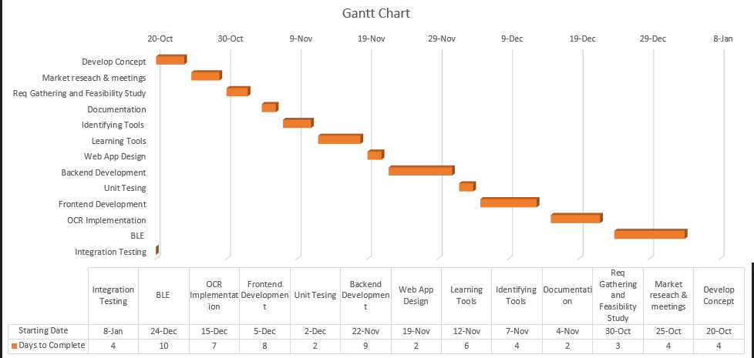
GANTT CHART-EXCEL

Slide 12
DOCUMENTATION-OPEN AI
Proposal
Software requirement specification
Feasibility Study
Software Design Specifications
Program development document
Data flow diagrams
Use-case Diagrams
Final project report
…GitHub Link:

Slide 13
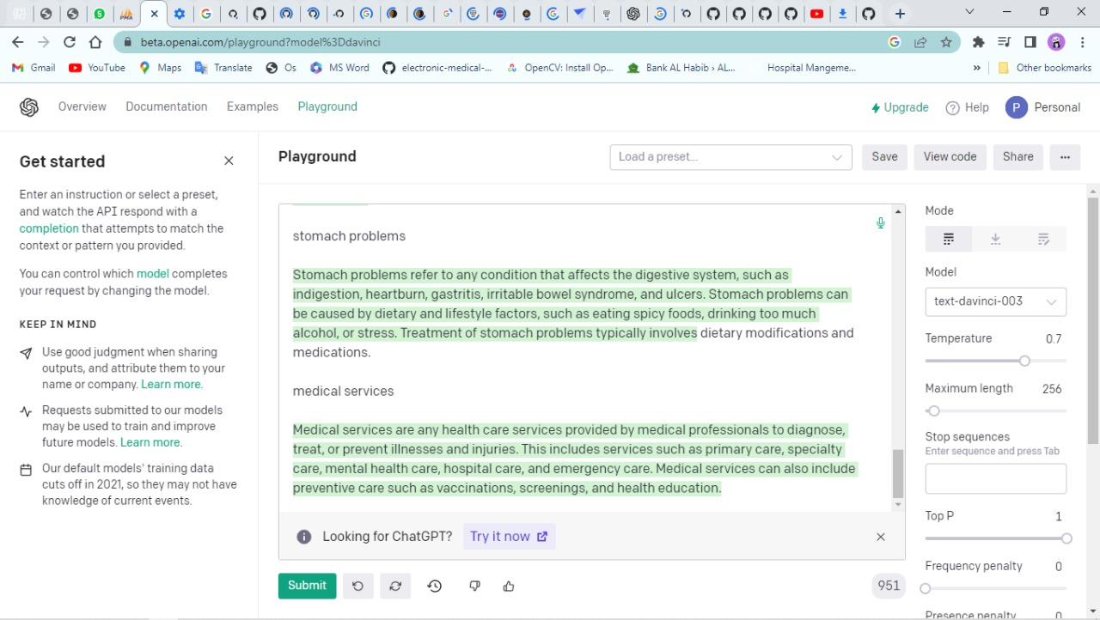
OPEN AI
https://beta.openai.com/playground?model%3Ddavinci

Slide 14
FEASIBILITY-SECURITY
Patient Identification
Admin Authority
Security
Modifications
Login ID

Slide 15
FEASIBILTY-PERFORMANCE
Response Time
Acknowledgment in just few seconds
Capacity
We aim to accommodate 40-50 users at a time
User-Interface
Acknowledges within five seconds
Maintainability
Efficiency for data backup
Reliability
Available all the time and it is durable

Slide 16
INTENDED AUDIANCE
01
02
CLIENT
SPECIFIC EMPLOYEES:
Consultants
Manager
Receptionists
System Operator

Slide 17
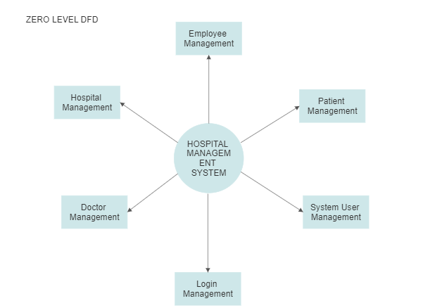
DATA FLOW MODELS

Slide 18
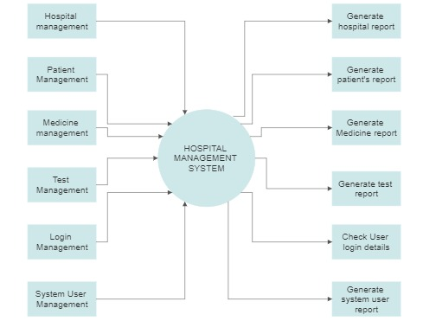
1ST LEVEL DATA FLOW MODEL

Slide 19
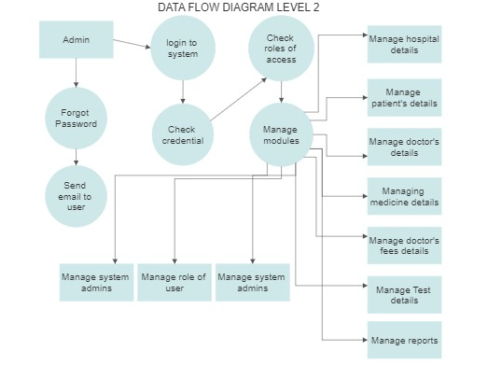
2ND LEVEL DATA FLOW MODEL

Slide 20
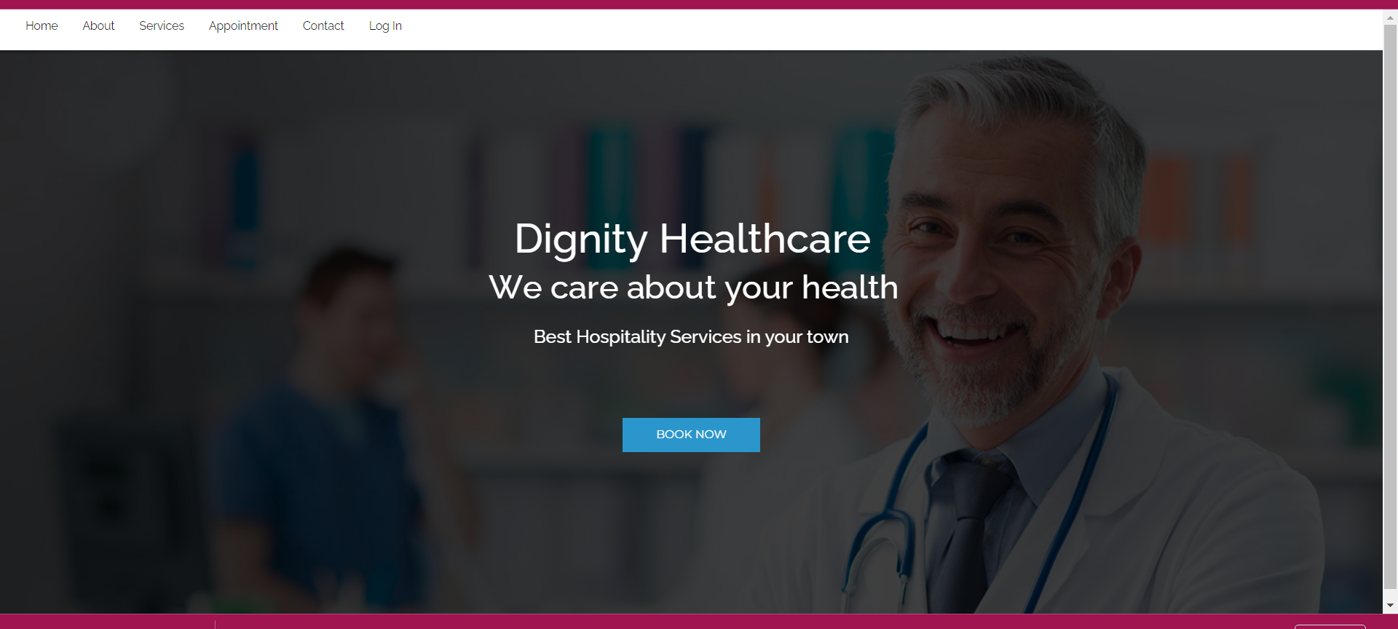
UI DESIGN
The User Interface
Homepage

Slide 21
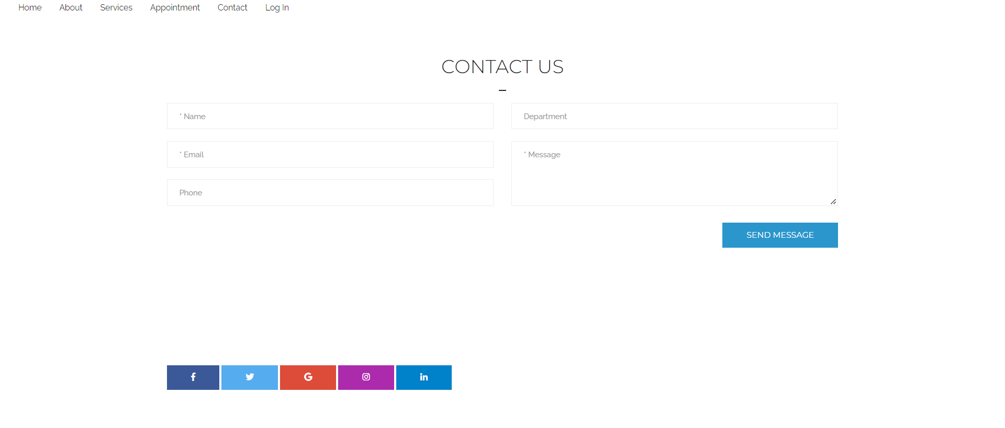
UI DESIGN
Contact page

Slide 22
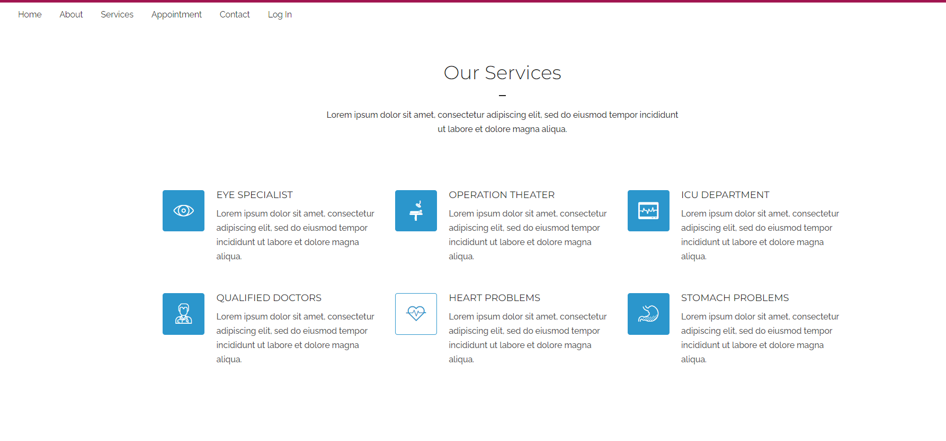
UI DESIGN
Service Page

Slide 23
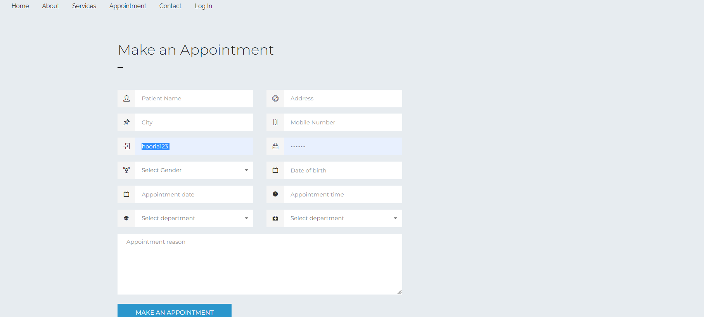
UI DESIGN
Appointment

Slide 24
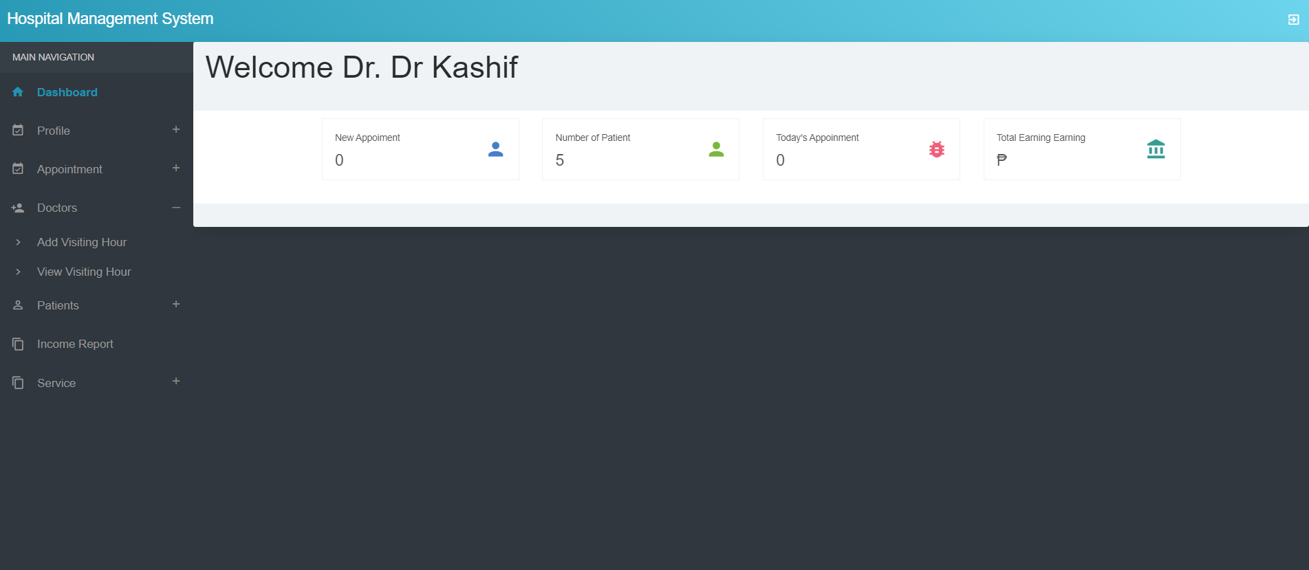
UI DESIGN
Doctor’s Dashboard

Slide 25
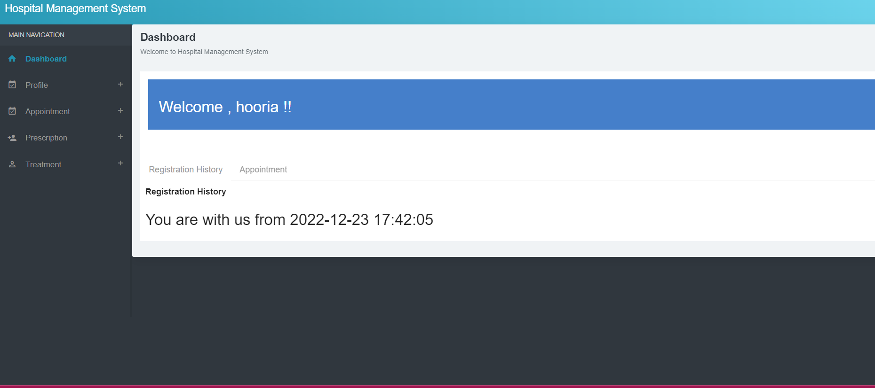
UI DESIGN
Patient Dashboard

Slide 26
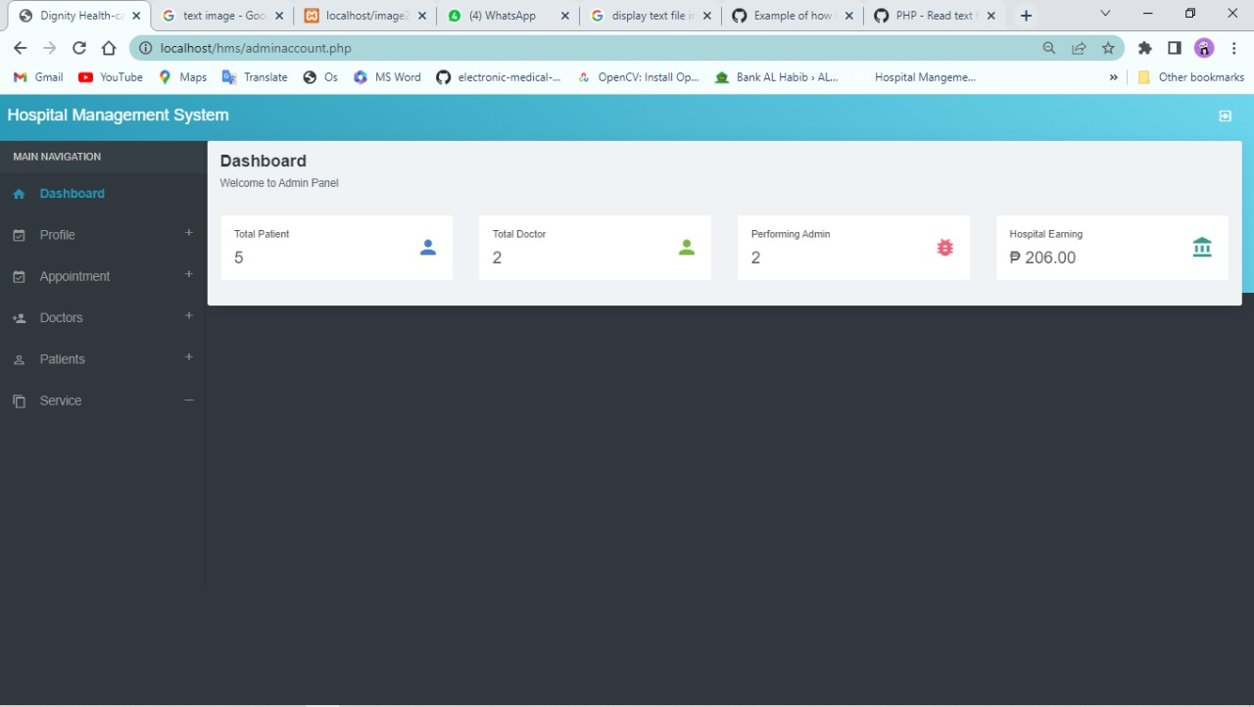
UI DESIGN
Admin’s Dashboard

Slide 27
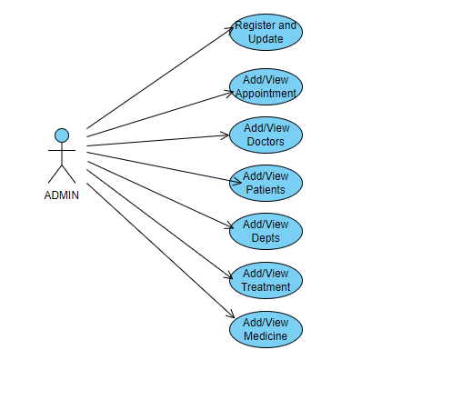
USE-CASE DIAGRAM

Slide 28
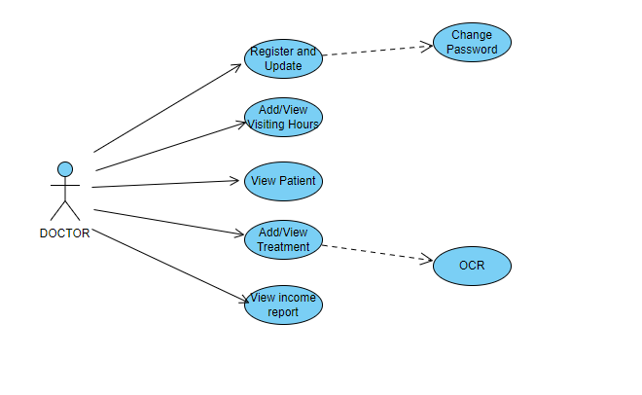
USE CASE DIAGRAM

Slide 29
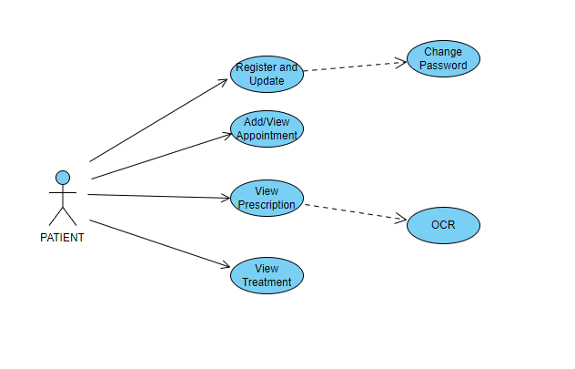
USE CASE DIAGRAM

Slide 30
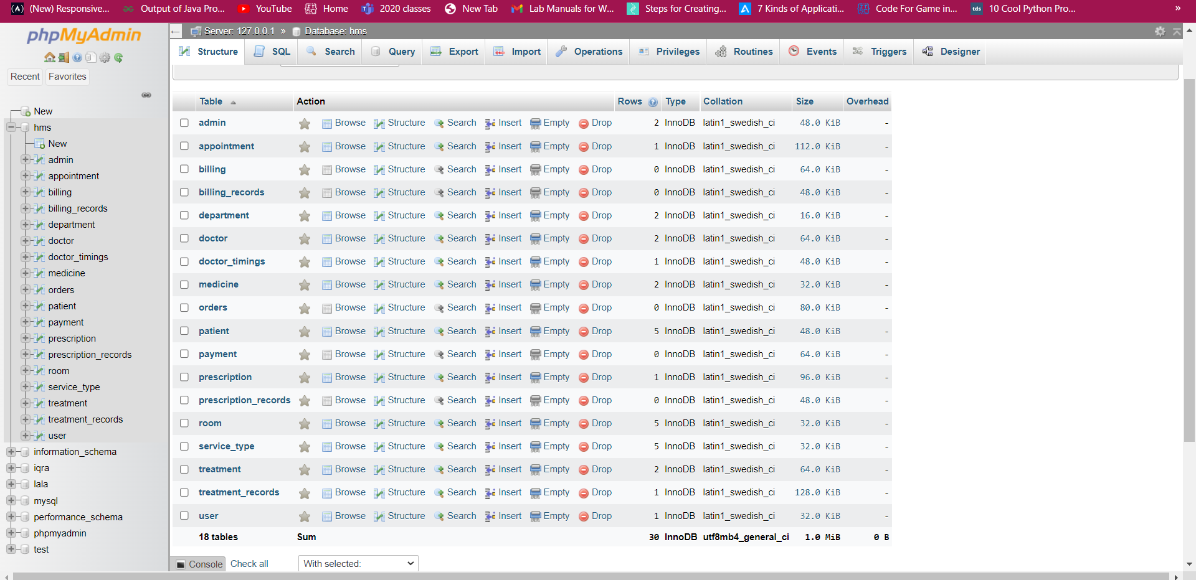
DATABASE TABLES
18 tables in database:

Slide 31
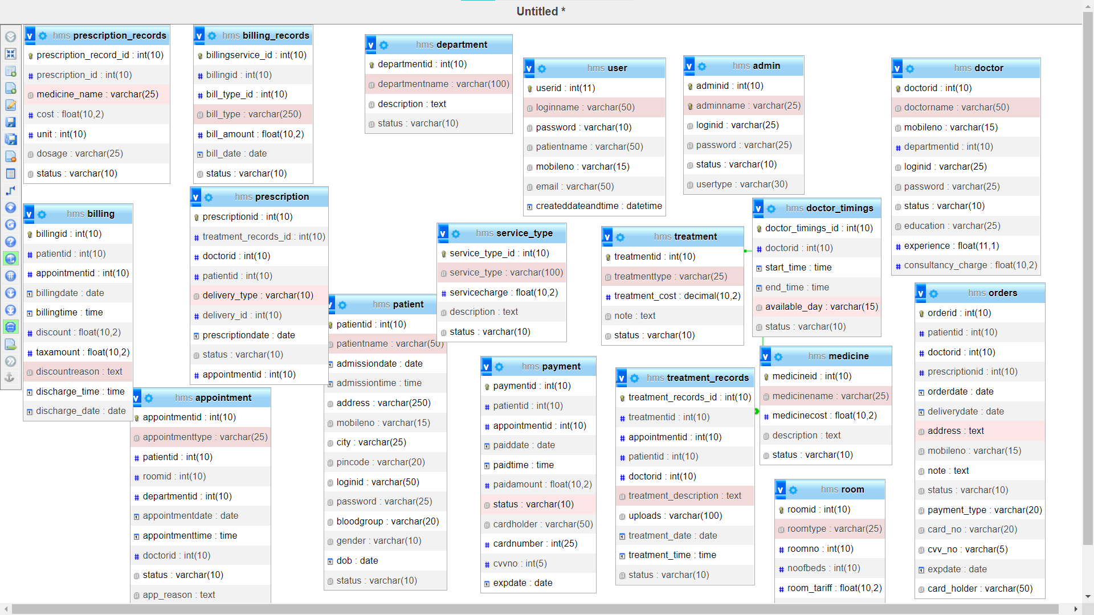
DATABASE DIAGRAMS

Slide 32
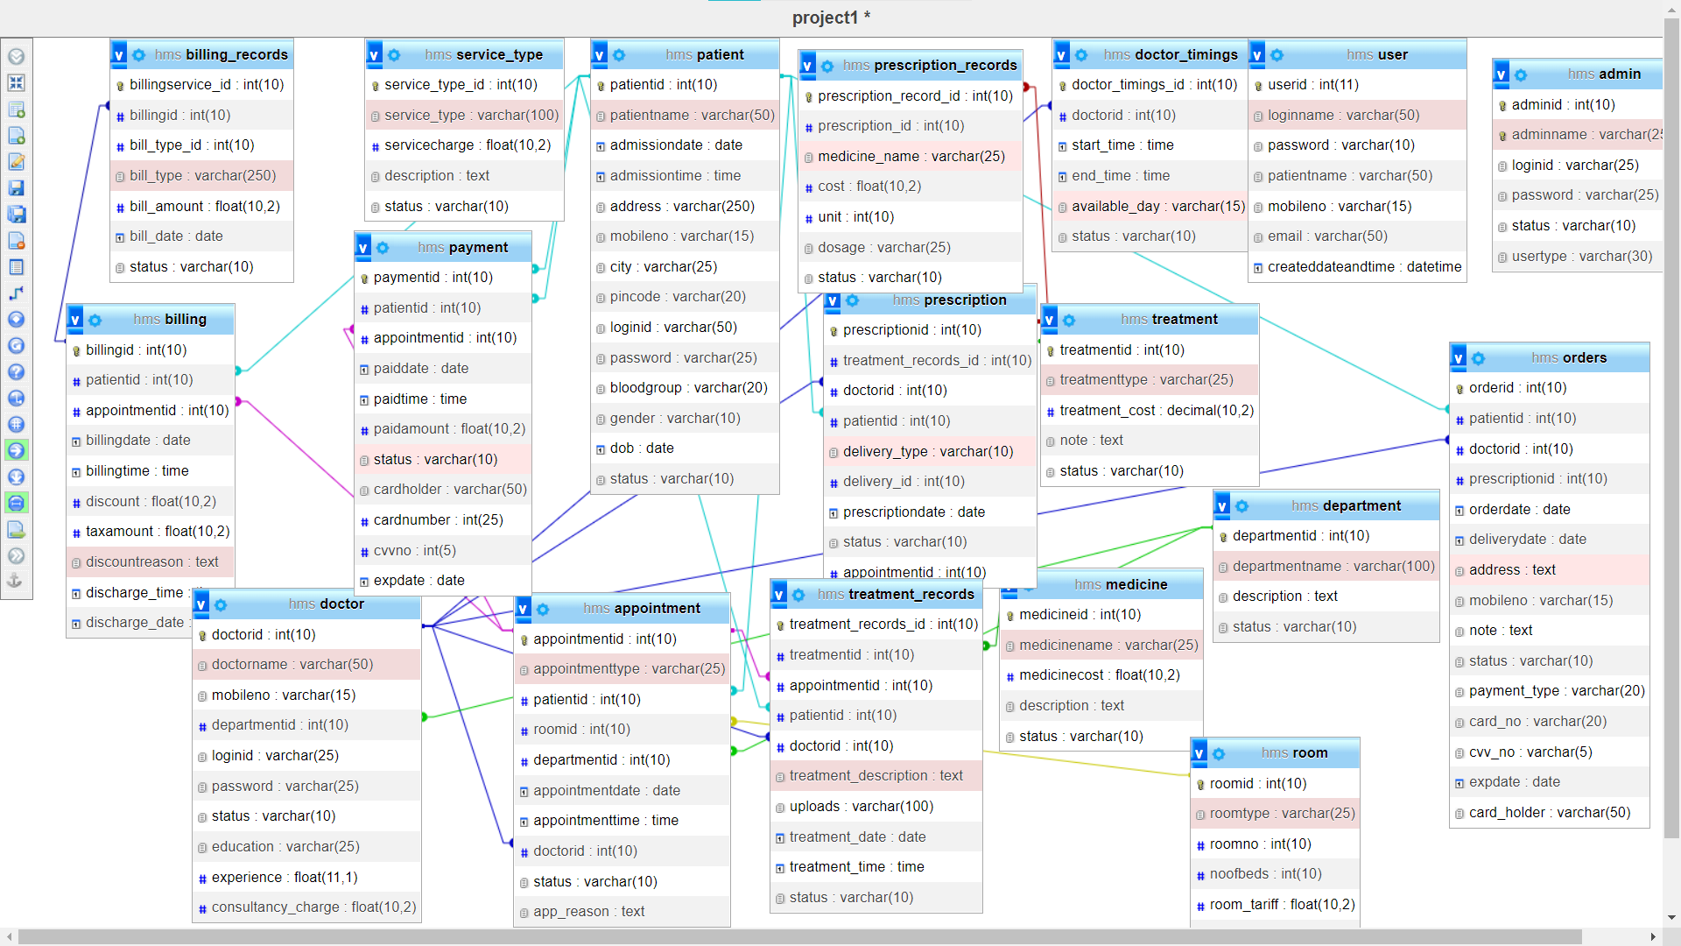
DATABASE DIAGRAM-RELATIONS

Slide 33
OCR-Tesseract
Tesseract
What is Tesseract?
OCR
Tesseract-source
https://www.chillyfacts.com/convert-image-to-text-optical-character-recognition-ocr-using-php
Tesseract in php
https://www.youtube.com/watch?v=CJM7elK-01I&t=580s

Slide 34
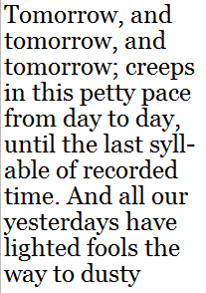
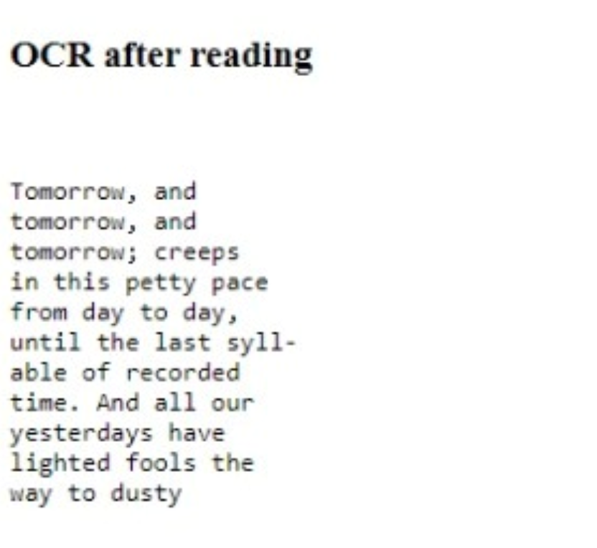
ROLE OF OCR
Image
Converted Text

Slide 35


